Slide 1



VI SEMESTER
BIG DATA TECHNOLOGIES
Phase-1
on
PredictMe:
A Big Data & ML Platform for College Admission Prediction

Slide 2
Team Members
Alroy Deon Saldanha | Aniket RT | Amogh AP
1RV23AI012 | 1RV23AI017 | 1RV23AI013

Slide 3
Introduction
India's national and state-level entrance exams (JEE, NEET, KCET, COMEDK) each publish their own cutoff and closing-rank data every admission cycle, spread across inconsistent government PDFs, spreadsheets, and portals.
PredictMe is an end-to-end Big Data and Machine Learning platform that ingests, cleans, and unifies this data at scale using Apache Spark.
Domain-specific ML models then estimate a student's admission probability for a given rank, category, and quota, instead of a rigid cutoff match.
Predictions are served through a FastAPI backend with Redis caching for sub-10ms responses, and a React frontend where students instantly explore “Safe” and “Likely” college options.
A single unified platform spans four exam domains — JEE (Engineering), NEET UG/PG (Medical), KCET, and COMEDK — bridging distributed data engineering with real-time predictive serving.

Slide 4
Identification of Problem
Every year, lakhs of JEE, NEET, KCET and COMEDK candidates receive a rank or percentile but have no reliable way to know which colleges and courses they can realistically get into.
Fragmented, messy source data: historical counselling and cutoff data is published as inconsistent CSVs, wide-header Excel sheets, and scanned tables across multiple rounds, categories, and quotas.
Scale beyond single machines: years of allotment records across four exam domains are too large for spreadsheets or single-threaded scripts to clean and query efficiently.
High-dimensional eligibility space: closing ranks vary independently across {Institute, Course, Category, Quota, Round}, which traditional relational lookups handle poorly at scale.
No sense of probability: naive nearest-rank lookups only give a rigid pass/fail answer; they cannot express how likely a student is to get a seat.
No unified, real-time tool: existing predictors are largely single-exam, non-scalable, and cannot serve lakhs of concurrent users during peak counselling season.

Slide 5
Literature Review
# | Paper | Year | Concept Defined | Research Gap
1 | Admission Prediction in Undergraduate Applications: An Interpretable Deep Learning Approach | 2024 | Uses an interpretable, attention-based deep learning model over applicant profiles to predict undergraduate admission decisions. | Built for a single institution's holistic review data; no support for multi-exam, rank-based public counselling systems or distributed processing.
2 | Quantifying Holistic Review: A Multi-Modal Approach to College Admissions Prediction | 2025 | Decomposes admission evaluation into human-aligned sub-components using multi-modal (text + numeric) features for transparent modeling. | Targets essay-driven US admissions; does not address rank/category/quota-based counselling used in Indian entrance exams (JEE/NEET/KCET).
3 | LLM-Augmented and Fair Machine Learning Framework for University Admission Prediction | 2025 | Combines structured academic/demographic data with LLM-derived text signals and fairness constraints for admission prediction. | Heavy LLM inference cost makes it unsuitable for low-latency, high-throughput prediction serving at scale.
4 | Machine Learning Based Prediction Model for College Admission | 2023 | Applies classical ML (Decision Tree, Random Forest, SVM) on historical cutoff/rank data to predict admission chances. | Single-domain, small-scale dataset processed on one machine; no distributed ingestion or category/quota-aware probabilistic modeling.
5 | A Big Data Analysis Framework Using Apache Spark and Deep Learning | 2018 | Combines Spark's distributed computation with a deep MLP model via cascade learning for scalable big-data analytics. | General-purpose framework not tailored to tabular rank/category prediction; no caching layer for repeated low-latency queries.

Slide 6
Literature Review
# | Paper | Year | Concept Defined | Research Gap
6 | Applying Machine Learning on Big Data With Apache Spark | 2025 | Benchmarks ML models (Linear/RF/GBT/SVR/KNN) within Spark MLlib across large regression and classification datasets. | Evaluated on generic datasets (taxi trips, Netflix, Higgs); does not explore ETL for messy, multi-format admission/counselling data.
7 | Benchmarking State-of-the-Art Gradient Boosting Algorithms for Classification | 2023 | Systematically compares GBM, XGBoost, LightGBM, and CatBoost on accuracy, runtime, and tuning cost with Bayesian optimization. | Purely a benchmarking study on generic datasets; findings not applied to a live, category-aware admission probability system.
8 | CatBoost: Gradient Boosting with Categorical Features Support | 2018 | Introduces CatBoost's ordered boosting and native categorical handling, outperforming tuned XGBoost with default parameters. | Focused on the algorithm itself; no discussion of deployment, real-time serving, or integration with a distributed data pipeline.
9 | Declarative Data Pipeline for Large Scale ML Services | 2025 | Proposes a modular “Pipes” framework that declaratively integrates ML capability inside Spark for large-scale ML services. | Emphasizes pipeline declarativity over user-facing low-latency serving or caching of repeated prediction queries.
10 | Accelerating Deep Learning Inference via Learned Caches | 2021 | Proposes learned/neural caches to reduce DNN inference latency in prediction serving systems. | Targets deep-learning inference caching; does not address simple, high-throughput key-based caching (e.g. Redis) for tree-based tabular models.

Slide 7
Literature Survey
Summary of Literature Survey
A clear shift from rigid cutoff lookups to ML-driven probability estimation (deep learning, gradient boosting) for admission and eligibility prediction.
Gradient boosting libraries (XGBoost, LightGBM, CatBoost) consistently outperform generic baselines on tabular, categorical-heavy data — motivating our use of CatBoost/XGBoost.
Apache Spark is widely used to scale ML pipelines, but most published pipelines target generic or single-domain datasets, not messy multi-format government counselling data.
Caching/serving research (learned caches, Redis-backed inference) shows large latency wins for repeated queries — a pattern well suited to admission prediction.
Most existing admission-prediction work is single-institution, single-exam, or purely academic, with no deployed real-time serving layer.
Our proposed system, PredictMe, unifies all of these: Spark-based distributed ETL across 4 exam domains, CatBoost/XGBoost probability modeling, Redis-cached FastAPI serving, and a real-time interactive frontend.

Slide 8
Problem Definition
Given a student's rank/percentile, category, quota, and exam domain (JEE/NEET/KCET/COMEDK), compute the probability of admission into every (Institute, Course) pair using historical closing-rank distributions.
Formally: build a pipeline Raw Counselling Data → Spark ETL → Feature Store → {Classifier for JEE, Regressors for NEET/KCET/COMEDK} → probability-ranked results (Safe / Likely).
Scale constraint: the pipeline must process millions of historical records across 4 exam domains despite messy, inconsistent source formats.
Latency constraint: repeated queries for the same {rank, category} combination must be served in well under 10ms via caching, not recomputed from scratch.
Interface constraint: results must be exposed through a responsive web UI usable by lakhs of concurrent students during peak counselling season.

Slide 9
Objectives
Build a distributed data pipeline: ingest, clean, and partition multi-year, multi-format JEE, NEET, KCET, and COMEDK counselling datasets using Apache Spark.
Engineer predictive features: aggregate historical {Institute, Course, Category, Quota} combinations into closing-rank distributions and store them in optimized Parquet format.
Train domain-specific ML models: use CatBoost/XGBoost classifiers (JEE) and regressors (NEET, KCET, COMEDK), tuned with Optuna, to output admission probabilities instead of rigid cutoffs.
Serve predictions in real time: expose a unified FastAPI backend with Redis caching so repeated rank/category queries return in milliseconds.
Deliver an interactive frontend: build a responsive React interface where students instantly see ranked “Safe” and “Likely” college-course options.

Slide 10
Methodology
Data Ingestion & Partitioning: raw JEE, NEET, KCET, and COMEDK counselling datasets are ingested and partitioned using Apache Spark, cleaning nulls and unifying inconsistent multi-line headers.
Storage & Feature Engineering: cleaned data is written to columnar Parquet storage; Spark aggregates records by {Institute, Course, Category, Quota} into historical closing-rank thresholds.
Model Training: domain-specific CatBoost/XGBoost models are trained — a probabilistic classifier for JEE and rank-gap regressors for NEET, KCET, and COMEDK — tuned with Optuna and evaluated via AUC/RMSE.
Prediction Serving: a FastAPI backend routes each domain's requests to its pre-trained model; Redis caches repeated {rank, category} queries to serve results in milliseconds.
Presentation Layer: a React/Vite frontend collects student input and renders ranked, color-coded (“Safe”/“Likely”) results in an interactive table.

Slide 11
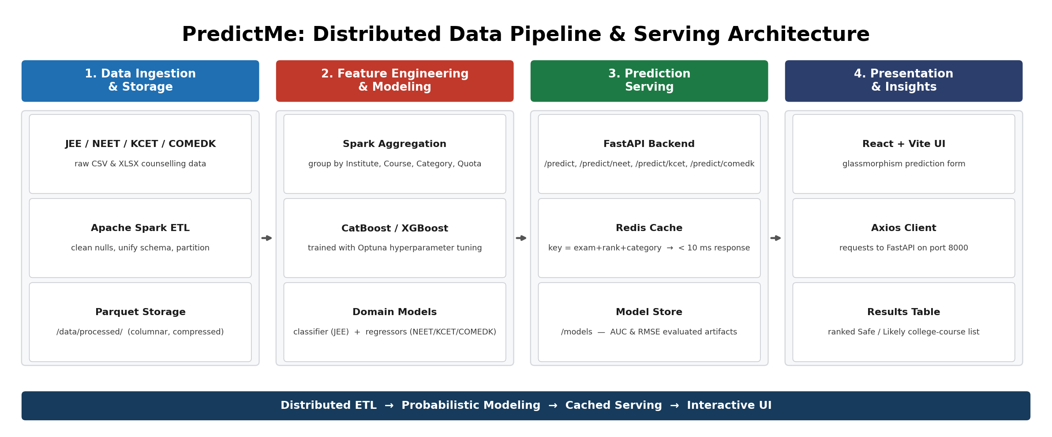
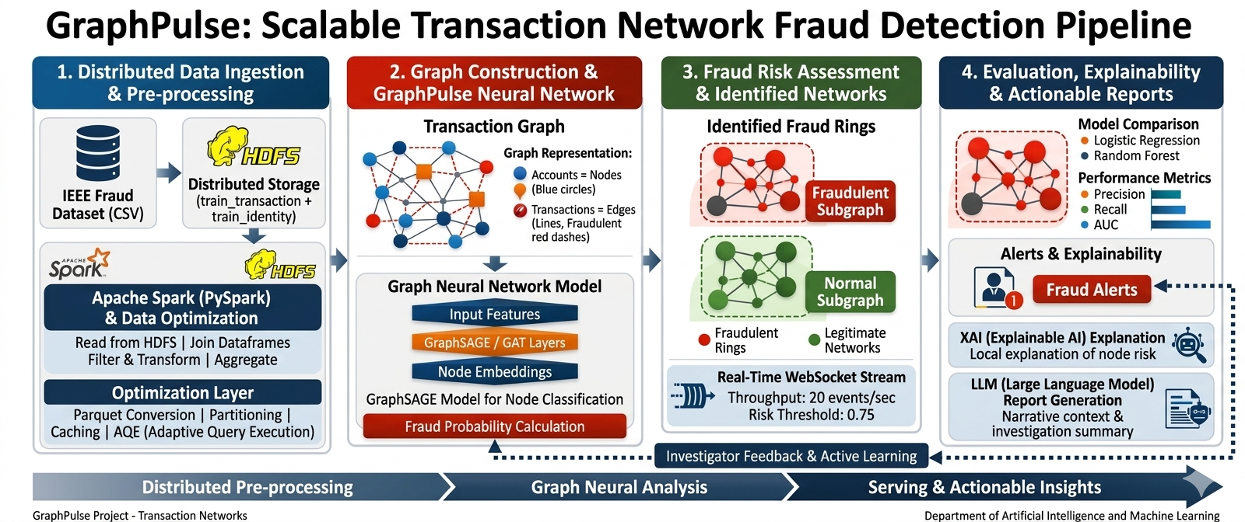
System Architecture

Slide 12
Proposed Tools and Techniques
1. Data Infrastructure
Apache Spark (PySpark) – distributed ETL — cleaning, filtering, and partitioning across all exam domains
Parquet – columnar storage for fast querying and reduced footprint (/data/processed/)
Docker (Spark Master/Worker + HDFS) – containerized big-data cluster for local development
2. Machine Learning Stack
CatBoost – categorical-feature-native classifiers/regressors for JEE, NEET, KCET, and COMEDK
XGBoost – gradient-boosted models for benchmarking and regression tasks
Optuna – automated hyperparameter tuning across model configurations
3. Serving & Backend
FastAPI – unified REST microservice routing /predict, /predict/neet, /predict/kcet, /predict/comedk
Redis – sub-10ms caching layer for repeated rank/category prediction queries
4. Frontend
React + Vite – glassmorphism UI for domain-based prediction forms
Axios – API communication with the FastAPI backend on port 8000
5. Data Sources
Official Counselling Datasets – historical JEE, NEET, KCET, and COMEDK allotment/cutoff records

Slide 13
Expected Outcome
A single, unified web platform where a student enters their rank/percentile, category, and quota for JEE, NEET UG/PG, KCET, or COMEDK and instantly receives a ranked list of eligible institutes and courses.
Probability-tiered recommendations (e.g. “Safe” ≥ 70% likelihood, “Likely” ≥ 40% for JEE; rank-gap based tiers for NEET/KCET/COMEDK) instead of a rigid pass/fail cutoff.
Distributed Spark pipelines capable of processing multi-year, multi-format counselling datasets end-to-end in minutes rather than hours.
Sub-10ms response times for repeated queries via Redis caching, supporting high concurrency during peak counselling season.
A reusable, extensible architecture — new exams or counselling rounds can be onboarded by adding an ingestion script and model, without changing the serving or frontend layers.

Slide 14
Conclusion
PredictMe shows how Big Data engineering (Apache Spark, HDFS, Parquet) and Machine Learning (CatBoost/XGBoost) can turn fragmented government counselling data into a fast, reliable admission-prediction service.
Replacing rigid cutoff lookups with probabilistic, category/quota-aware predictions gives students a realistic, data-driven view of their admission chances across four major Indian entrance exams.
The Redis-cached FastAPI serving layer and React frontend show that Big Data pipelines can be delivered as a responsive, real-time product, not just an offline analytics exercise.
Future work includes covering more state-level exams, incorporating live counselling-round updates, and adding explainability so students understand why a college is marked “Safe” or “Likely”.

Slide 15
Thank You

